Slide 1
Parking Lot ServiCe
Modelling Traffic control in a smart parking garage Marcus Debnar S2310454007, Stefan Habringer S2310454013

Slide 2
Project Idea
Modelling smart parking system
Model of a physical parking deck
Counts number of vehicles and occupied parking spaces
Visualization with sensors and software frontend

Slide 3
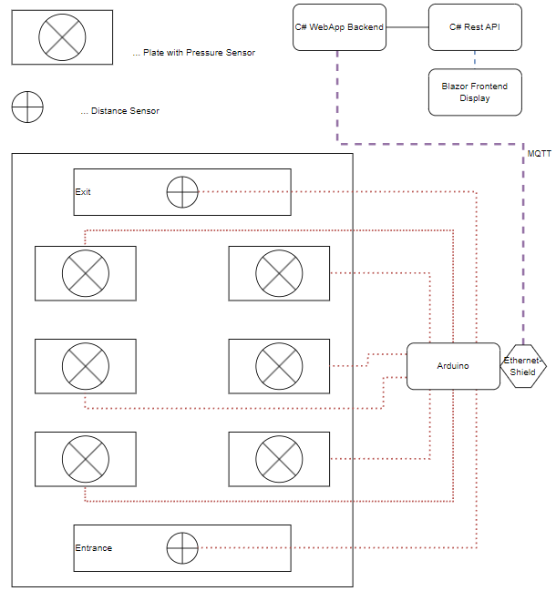
ARCHiTECTURE
Pressure and distance sensors
Ethernet Shield – MQTT
Asp.Net Application and Blazor Frontend

Slide 4
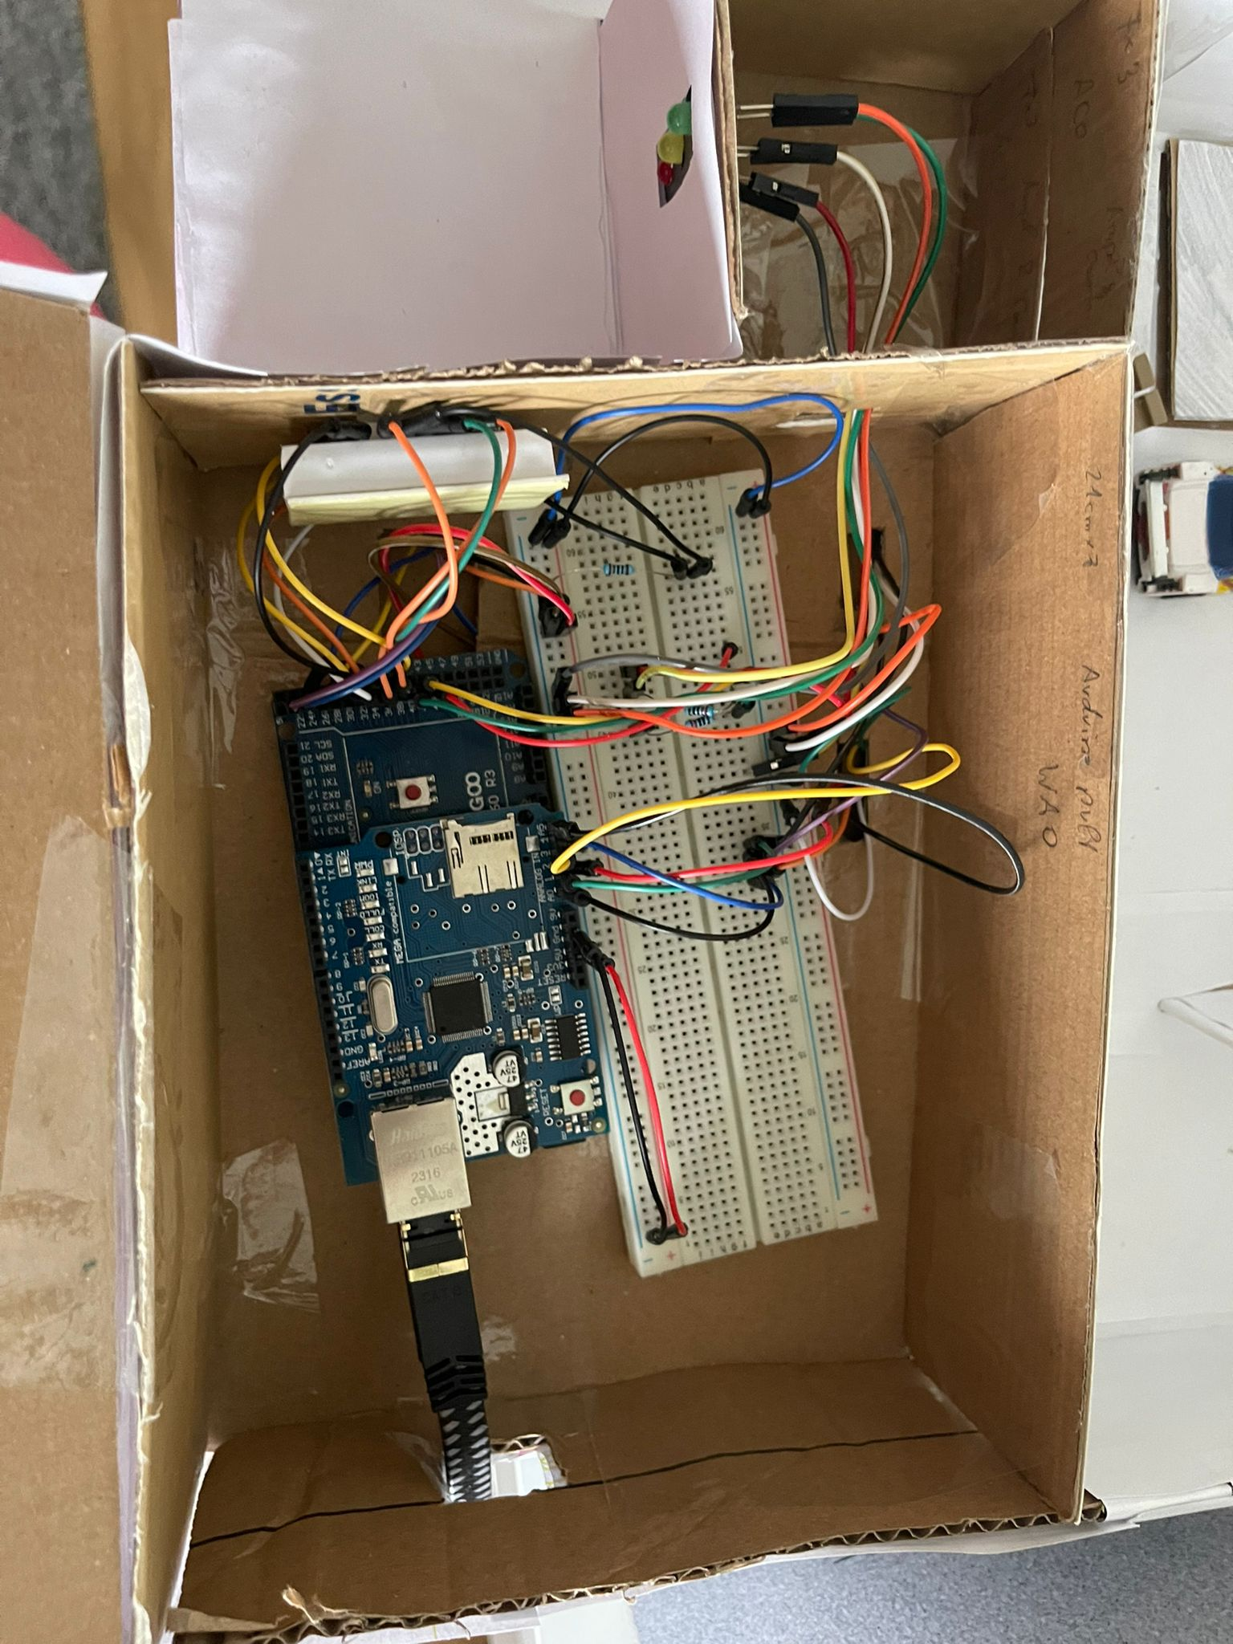
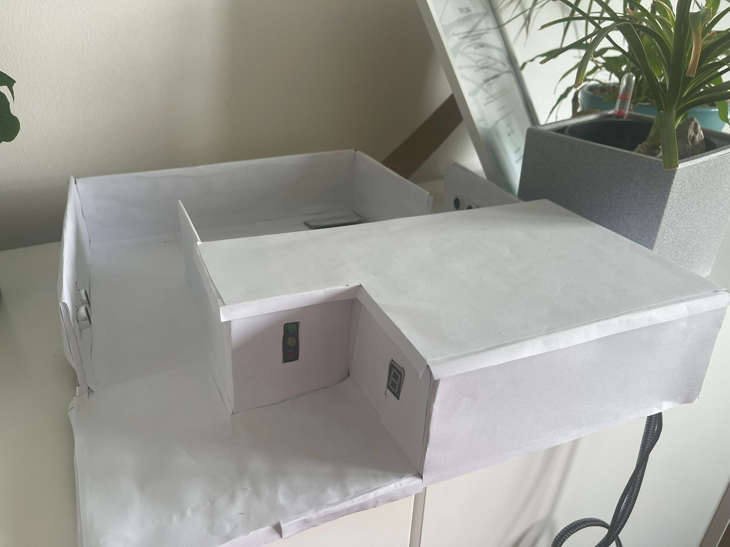
Hardware Development
Multiple Iterations of the physical representation
Shortcut
Hardware limitation of the arduino – number of connections

Slide 5
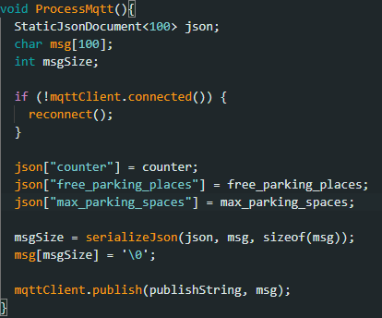
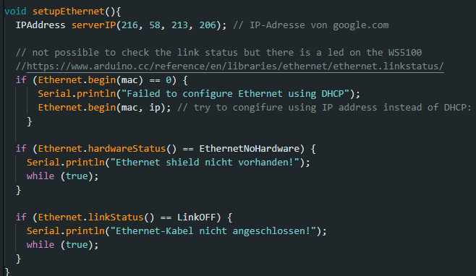
Hardware Developmen
Multiple Iterations of the physical representation
Shortcut
Hardware limitation of the arduino – number of connections

Slide 6
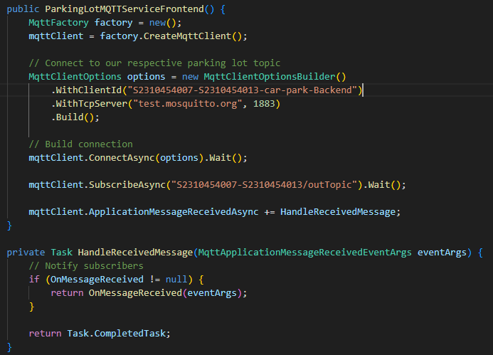
Software Development
Arduino code was easy to implement but hard to finetune
Backend connection to MQTT broker
Message Propagation
Subscription
API

Slide 7
Lessons Learned
Arduino setup non optimal - Easier with physical model
MQTT Logic – placement and propagation
Integration Arduino – MQTT – C# Backend / Frontend

Slide 8
